Slide 1
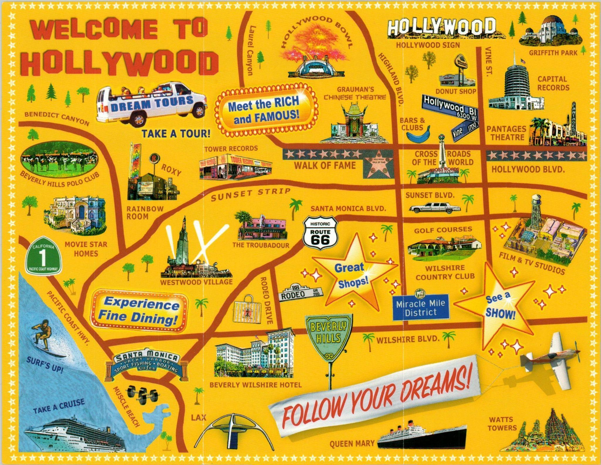
Hollywood Studio System
Golden Age of Cinema

Slide 2

Film Age
Arnold Hauser The Social History of Art
Combination of spatial and temporal forms
Intensive aesthetic effects in the film
Petit Bourgeois Mass Media

Slide 3
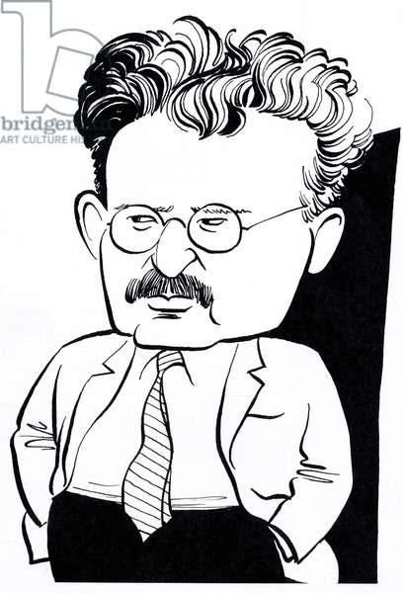
Modern Novels
The de-psychologization of the novel already begins with Proust, who, as the greatest master of the analysis of feelings and thoughts, marks the summit of the psychological novel, but also represents the incipient displacement of the soul in the balance of reality. In the novel of the nineteenth century, the soul and character of man are seen as the opposite pole to the world of physical reality, and psychology as the conflict between the subject and object, the self and the non-self, the human spirit and the external world. This psychology ceases to be predominant in Proust.

Slide 4
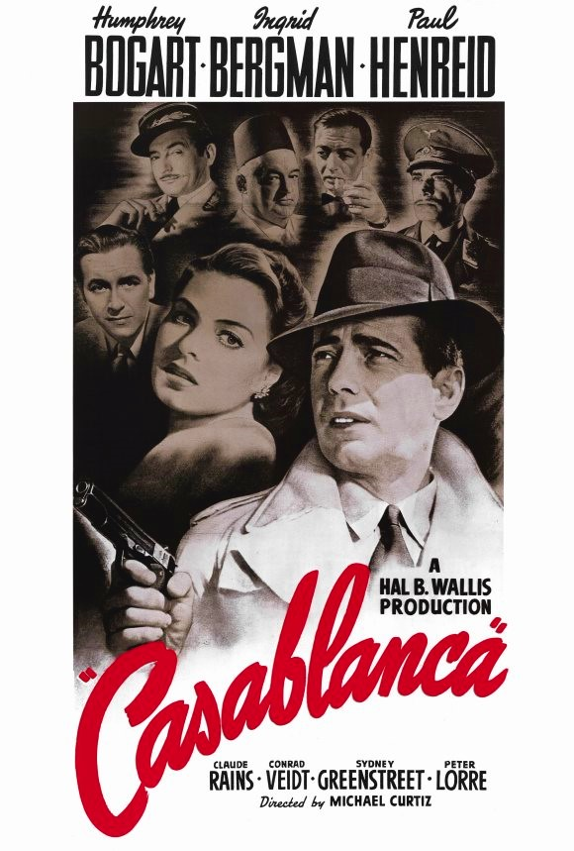
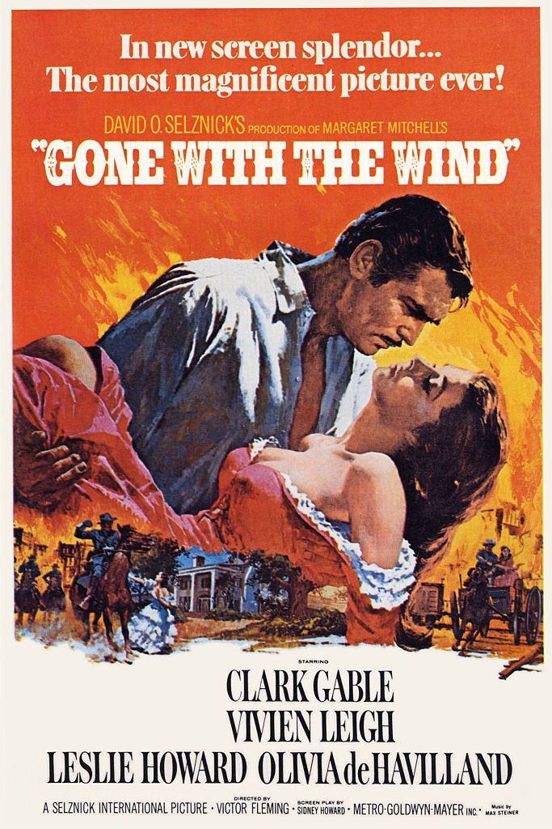
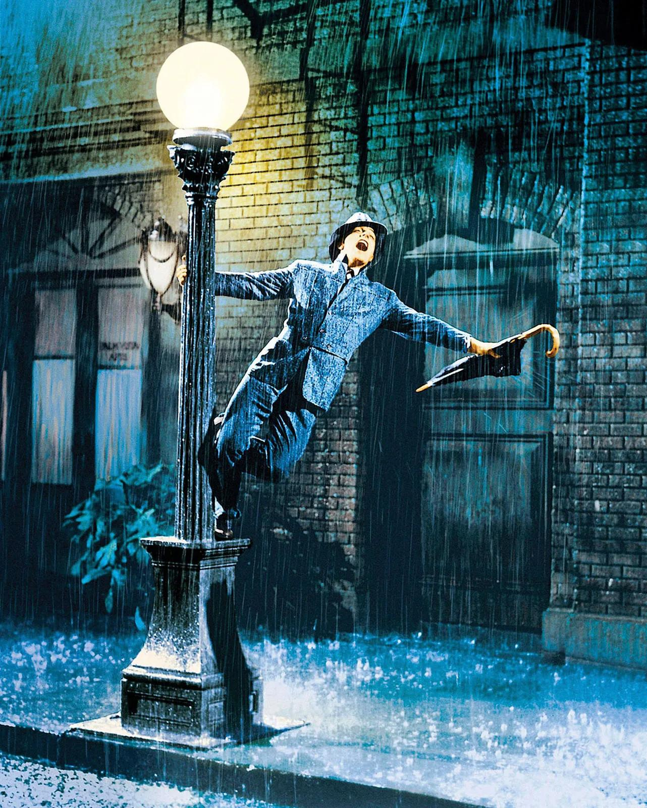
golden age of the Hollywood studio system
American Cinema: late 1920s - early 1960s
Gone with the Wind
Casablanca
Singin' in the Rain

Slide 5
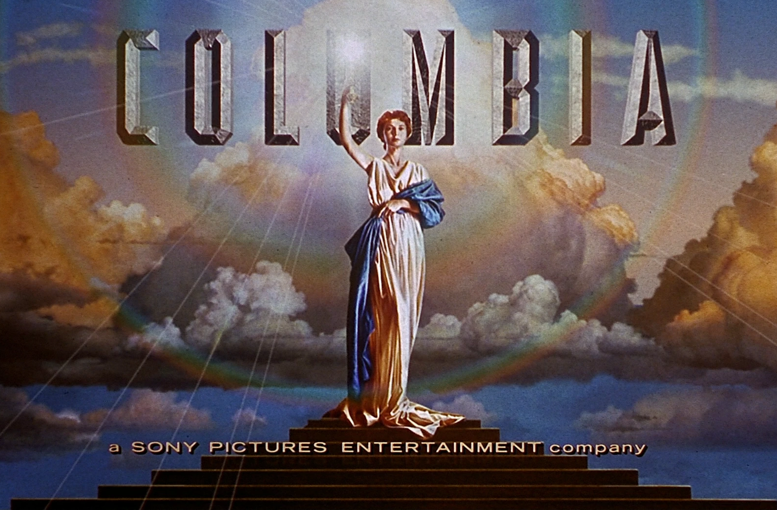



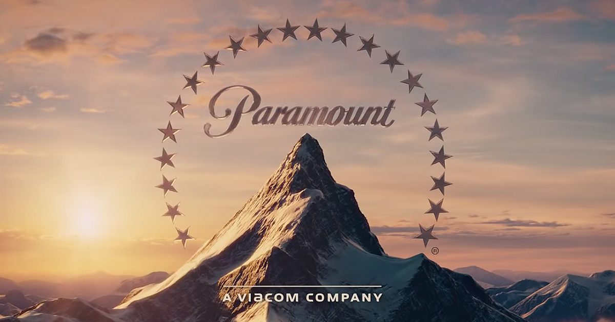

major film studios in Hollywood
highly centralized and standardized system that dominated the film industry
Vertical integration: tight grip on the film industry and to maximize their profits
Financing
Production
Distribution
Exhibition

Slide 6


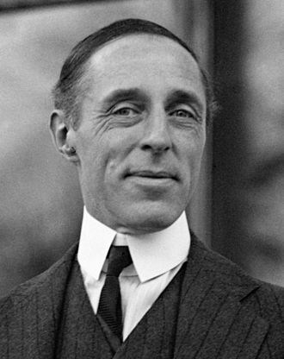
Creative Control
Frank Capra in 1939 “Only half a dozen directors in Hollywood who are allowed to shoot as they please and who have any supervision over their editing”
Running time
Mob Scenes
close-up

Slide 7

Genre specialization
a particular area of expertise, producing films in specific genres or styles that catered to particular audience demographics.
(Romantic) Comedy
Film Noir
Thriller - Suspense
SF
Action
Horror

Slide 8
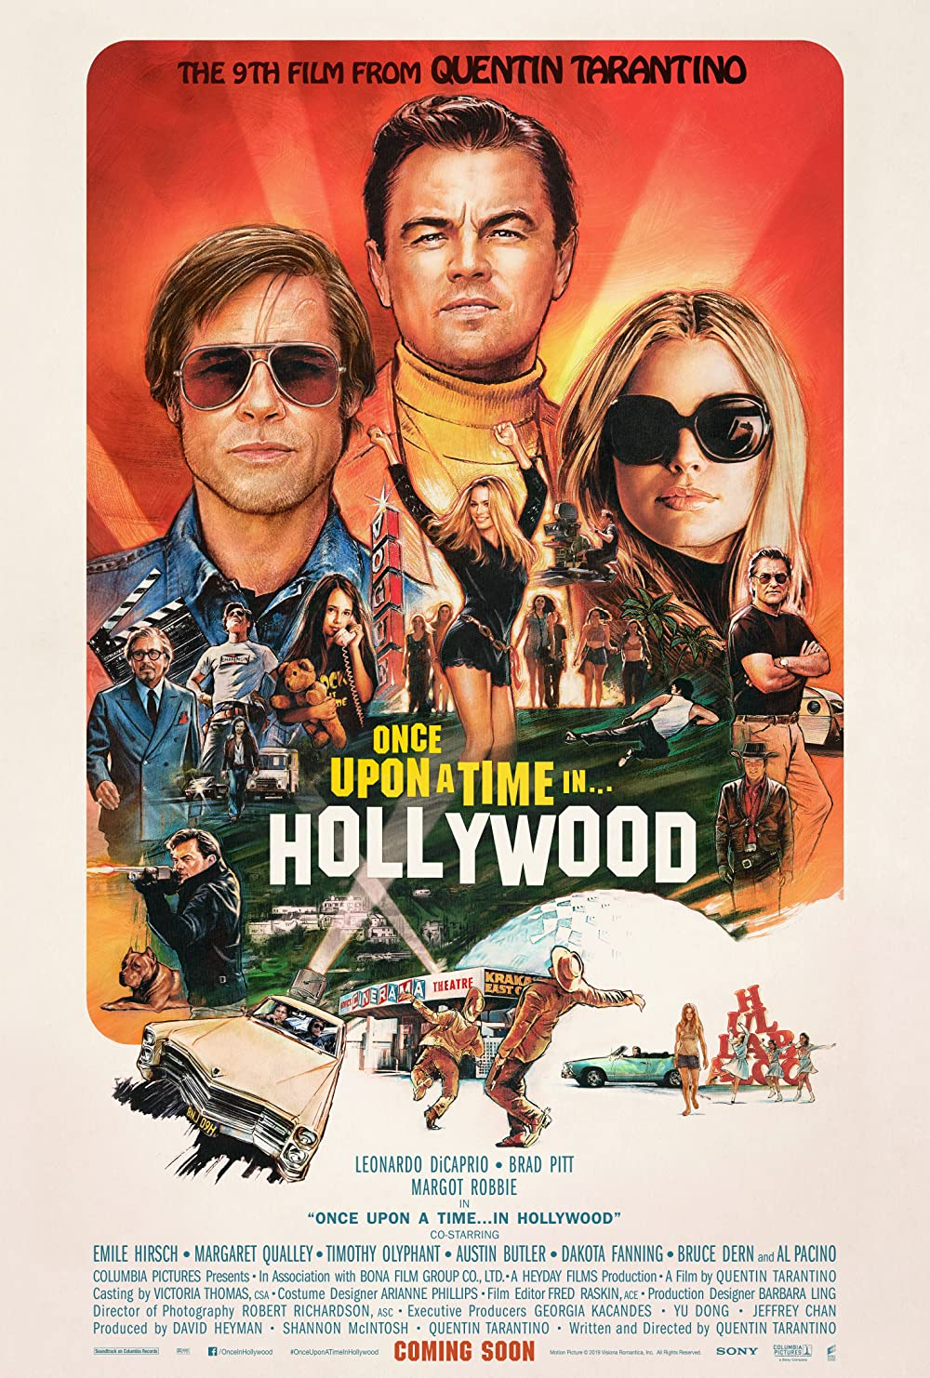

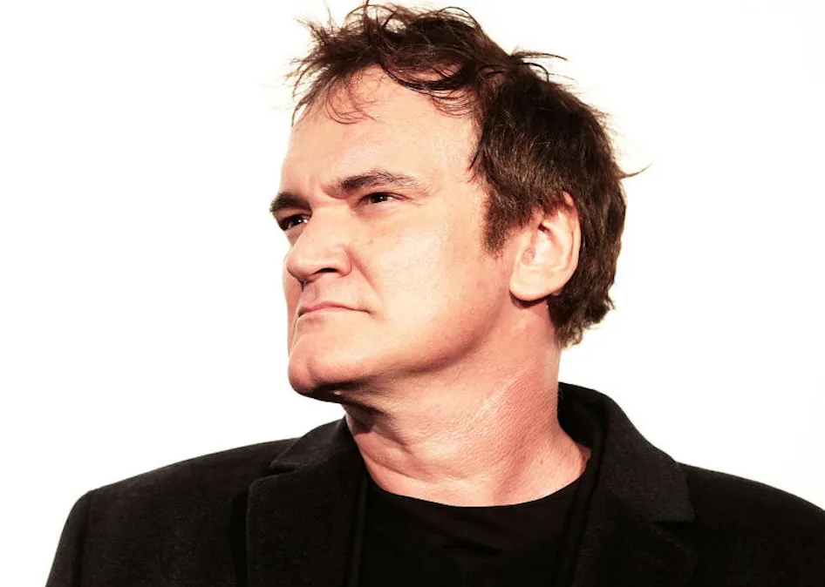
Contract system
Actors, directors, and other creative personnel were typically under contract to a specific studio, which gave the studios even more control over the films they produced.
Harvey Weinstein - Quentin Tarantino

Slide 9

Totality
the interconnectedness and interdependence of different art movements, styles, and periods
Mass Public: democratization of enjoyment of art
Success with them is completely divorced from qualitative criteria.

Slide 10
Piece bien faite: Petit Bourgeois Attitude
Disorientation of rootless elements of society
thoughtless, uncritical optimism
ultimate unimportance of social differences
people simply walk out of one social stratum into another

Slide 11
Petit Bourgeois Fantasy
Everyone is the architect of his own fortune
Life never can realizes social romanticism and the lending libraries never realize so deceptively as the film with its illusionism

Slide 12
Conclusion
The problem is not to confine art to the present-day horizon of the broad masses, but to extend the horizon of the masses as much as possible.
Genuine, progressive, creative art can only mean a complicated art today.
It will never be possible for everyone to enjoy and appreciate it in equal measure, but the share of the broader masses in it can be increased and deepened.
The preconditions of a slackening of the cultural monopoly are above all economic and social. We can do no other than fight for the creation of these preconditions

